Slide 1
Analyzing Childcare Prices Across the U.S.
DSC640-T301 Data Presentation & Visualization
Joseph Damico

Slide 2

Importance of understanding childcare prices in economic policymaking.
The Cost of Living Index serves as a critical tool for assessing economic wellbeing. Understanding childcare prices is essential for policymakers as these costs directly impact family budgets and economic stability.
This analysis is based on the National Database of Childcare Prices, encompassing data from various states over multiple years.

Slide 3

Chosen Data
UNR_16:
This stands for "Urban Non-Relative Childcare Cost in 2016." It represents the average cost of childcare in urban areas for non-relative care (like babysitters or family daycare) in the year 2016.
FUNR_16:
This refers to "Family and Relative Non-Relative Childcare Cost in 2016." It indicates the average cost of childcare provided by family members or relatives in urban settings during the year 2016.
MUNR_16:
This signifies "Mixed Non-Relative Childcare Cost in 2016." This term often encompasses a combination of different types of childcare arrangements, potentially including both formal and informal care providers, in urban settings for the year 2016.

Slide 4
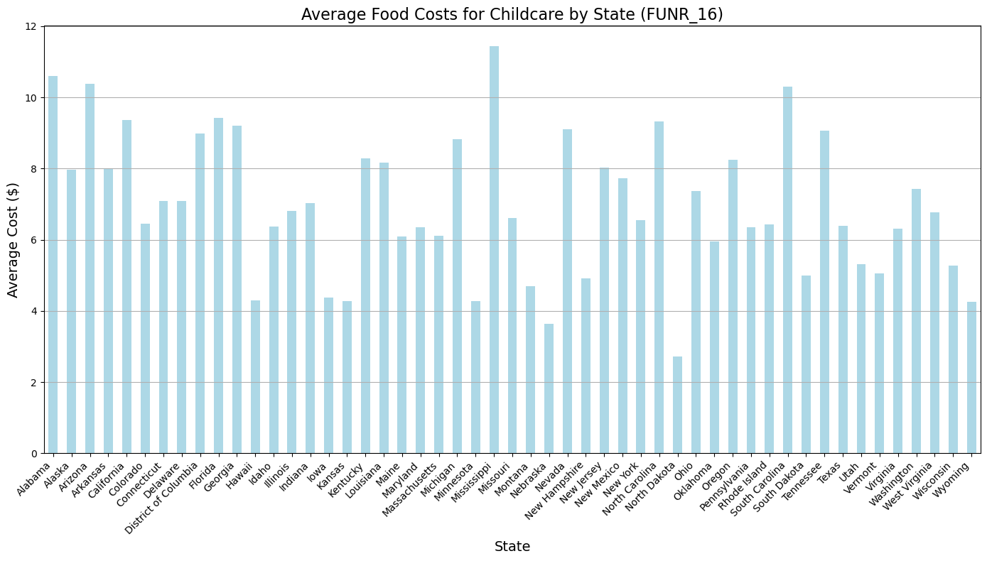
Bar Chart of Average Food Costs by State
Key findings reveal significant variability in childcare costs across states, with urban areas often experiencing higher prices. This variability is essential for understanding the financial pressures on families.

Slide 5
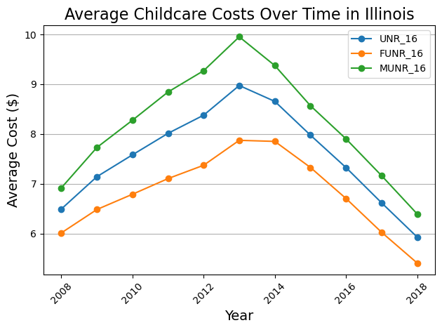
Average costs in Illinois.
This line chart illustrates how average childcare costs have evolved over time in Illinois, revealing trends that can inform future economic policy decisions.

Slide 6
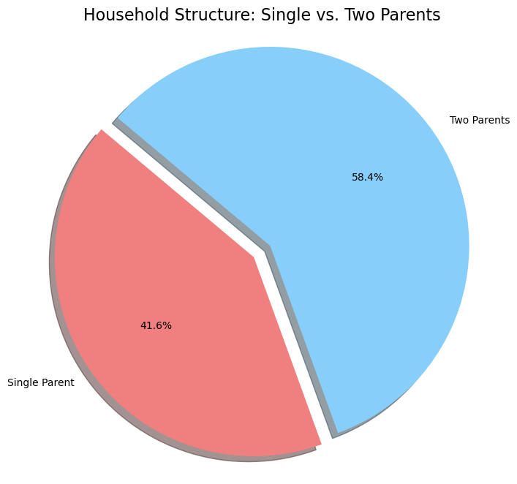
Demographic Analysis
Single-parent households face unique financial challenges, and this pie chart highlights the demographic breakdown, showcasing the need for targeted economic support.

Slide 7
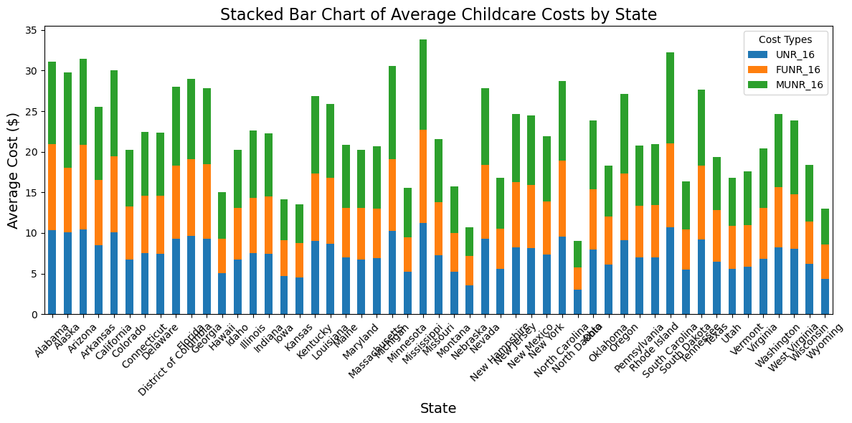
Average Childcare Costs by State
This slide presents a stacked bar chart that compares the average childcare costs across different states, categorized by three types of childcare expenses.

Slide 8
Overall Implications of Findings
In conclusion, this analysis highlights the critical role that childcare prices play in family budgets. Understanding these dynamics is essential for developing effective economic policies that support families in need.

